Slide 1

Energy-Efficient and Power-Constrained Techniques for Exascale Computing
Stephanie Labasan
Computer and Information Science
University of Oregon
17 October 2016

Slide 2
Overview
Motivation: Power is becoming a leading design constraint in HPC
Goal: Save energy/power
Ideas: Reduce CPU clock frequency or place a power cap on the CPU
Proposition for users: Run X% slower, save Y% in energy/power
Notes:
The topics that will be discussed in this presentation are motivated by the fact that power is becoming a leading design constraint in HPC..
This leads to the following proposition for users: if you’re willing to run X% slower, then you can save Y% in energy/power.

Slide 3
Outline
Motivation & Background
Energy-Efficient Techniques for HPC
Power-Constrained Techniques for HPC
Scientific Visualization
Power-Aware Visualization & Future Work
Notes:
First, I’ll cover some background information.

Slide 4


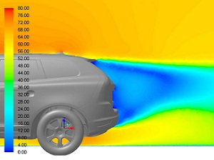

What is High-Performance Computing?
Enabling technology for scientific discoveries through simulation
Weather prediction, design simulation, genomics research, medical imaging, and more!
Leverages computational capacity of several thousand interconnected processing units
Notes:
HPC is a unique technology allowing our scientists and engineers to solve the most complex scientific problems, such as climate and weather prediction and medical imaging. Specifically, HPC enables our scientists to solve these complex problems through simulation. These simulations require large amounts of bandwidth and storage, as well as high computational capacities of several thousand interconnected nodes, typically more than 1 order of magnitude more than what’s on a laptop or desktop. So we look to HPC systems, such as supercomputers, as they provide us with the resources needed to solve these problems.

Slide 5
Large Supercomputers
Performance measured in FLOPS = floating-point operations per second
Linpack: highly-optimized compute- intensive standard benchmark
1 TeraFLOP = 10¹² [1997]
1 PetaFLOP = 1K TeraFLOPS [2008]
1 ExaFLOP = 1M TeraFLOPS [exp 2023]
Notes:
In order to quantify how large and powerful these supercomputers are, we look at their performance usually measured in FLOPS or the number of floating-point operations per single second a system can complete. The performance is determined when running a highly optimized, computationally intensive benchmark known as Linpack.

Slide 6
High Power Costs
1 MW of power costs $1M per year
Supercomputing centers are paying ~$12M annually
As machines get larger, cost rises, unless we innovate power-efficient techniques
Techniques may come from HW, but SW as well
Rank | System | Cores | Rmax (PFLOPS) | Power (MW)
1 | Sunway TaihuLight, China | 10.6M | 93 | 15.4
2 | Tianhe-2, China | 3.12M | 33.9 | 17.8
3 | Titan, ORNL | 560K | 17.6 | 8.2
4 | Sequoia, LLNL | 1.57M | 17.2 | 7.9
c/o Top500, Jun2016
Notes:
Twice a year, the HPC community releases a list known as the Top500, which ranks the top supercomputers by the FLOPS metric. On the right I show the top 4 supercomputers as of this past June. In addition to their high computational performance, they also have high power consumption. The typical assumption is that 1 MW of power cost…

Slide 7
What is Energy? What is Power?
Energy
Power
Units: Joules, kiloWatt-hour
Total work done
Monthly bill from electric company (e.g., $.11/kWh) – “power bill”
Units: Joules/second, Watts
Instantaneous rate of energy usage
Lightbulb ratings, microwaves, stereo systems
Notes:
Before we dive any further, let me take a moment to define some key terms for this presentation.

Slide 8
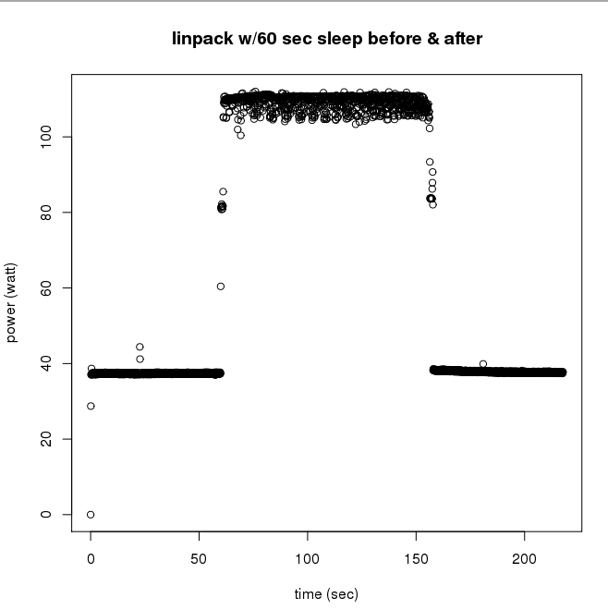
CPU Power Usage Varies Over Time
Base power usage for idle state
When more HW components are engaged (cache, vector units, etc.), power rises
Energy usage would be the area under this power curve
Computationally-intensive HPC benchmark (Linpack) running on small cluster
Notes:
The power that a processor uses will vary over the lifetime of an application.

Slide 9
Save Energy? Save Power?
Energy
Power
For a single application execution, minimize energy consumption ($$)
Energy-to-solution
Mobile, desktop, workstations, data centers
Reduce rate at which application consumes energy
Save power != Save $$/energy
Run at 40W take 10s = 400J
Run at 30W take 15s = 450J
Supercomputers
Increase concurrent jobs (maximize completed jobs)
Notes:
Mobile processors and software have been optimized to use energy-efficient techniques to extend battery life, so we’re not charging multiple times throughout the day. There are also some data centers that enforce an energy bound on a per job basis, so it's up to the application developers to ensure their algorithms are energy efficient

Slide 10
Increasing Machine Throughput
Scenario 1
Scenario 2
Launch a single job with maximum power allocation available
No other concurrent jobs can be launched without exceeding the bound
Launch the same job at a lower power allocation, job runs longer
Power available to launch other concurrent jobs → increase amount of science done
System Power Bound
System Power Bound
JobA
JobC
Power
Power
JobB
JobA
Time
Time
Notes:
Let’s assume we have a system power bound. We have two scenarios. First, we could launch a single job and have it consume all the power during its execution. This means we can’t simultaneously launch any other jobs without exceeding the bound.

Slide 11
U.S. Department of Energy Perspectives on Exascale Challenges
Parameter | 2010 | “2018” | Difference Today & “2018”
System peak | 2 PFLOPS | 1 EFLOPS | O(1000)
Power | 6 MW | ~20 MW | ~3
System memory | 0.3 PB | 32-64 PB [.03 Bytes/Flop] | O(100)
Node performance | 125 GF | 1,2 or 15 TF | O(10)-O(100)
Node memory BW | 25 GB/s | 2- 4 TB/s [.002 Bytes/Flop] | O(100)
Node concurrency | 12 | O(1k) or 10k | O(100)-O(1000)
Total node interconnect BW | 3.5 GB/s | 200-400GB/s | O(100)
System size (nodes) | 18,700 | O(100,000) to O(1M) | O(100)-O(1000)
Total concurrency | 225,000 | O(billion) [O(10) to O(100) for latency hiding] | O(100)
Storage | 15 PB | 500-1000 PB (>10x system memory in min) | O(10)-O(100)
IO | 0.2 TB | 60 TB/s (how long to drain the machine) | O(100)
Mean time to failure | Days | O(1 day) | - O(10)
Parameter | 2010 | “2018”
System peak | 2 PFLOPS | 1 EFLOPS
Power | 6 MW | ~20 MW
Until now, innovations in power savings have been hardware driven.
However, to reach 1 Exaflop/20 MW, software improvements may be needed.
c/o P Beckman
Notes:
The DoE has defined its perspectives on the challenges at exascale, which are presented here in this table. I want to focus our attention on two of them here.
In 2010 when this projection was first made, the challenge to achieving exascale was increasing computation by 3 orders of magnitude but only increasing power consumption by 1 order of magnitude. In other words, we needed to be 100X more power-efficient. Since then, there have been several power-efficiency innovations to reduce the power-efficient factor. These have mostly been driven by hardware, such as the integration of GPU and many-core. In order to reach our goal at the 20MW power cap set by the Dept of Energy, software improvements may also be needed to complement our hardware solutions.

Slide 12
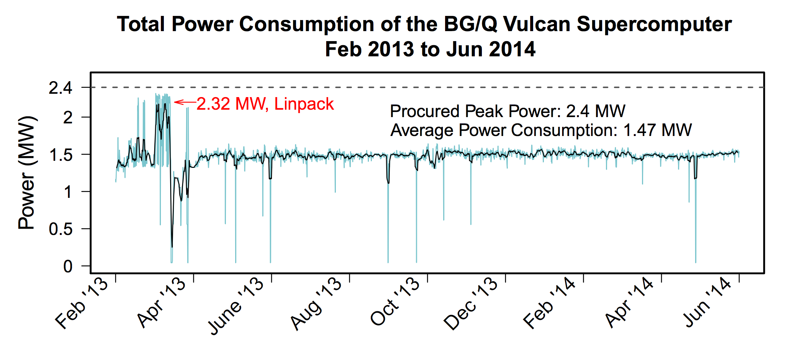
Future Systems: Max Power < 20MW
Machine reaches maximum power assuming worst-case compute-bound application
i.e., even Linpack stays below 20 MW
Performance left unused!
20
1 EF, peak
Linpack
←
Linpack
0.7 EF, “usable”
Time
Data set c/o T Patki
Notes:
There are two possible scenarios concerning power on future exascale systems. The first is that the machine consumes at or below 20 MW, meaning even the most compute-intensive application stays at or below this bound.

Slide 13
Future Systems: Max Power > 20MW
Machine contains more compute capacity than can be running simultaneously under the power bound
Controls needed to enforce power usage at 20 MW
Power allocations are coordinated by a central manager
?
20
1 EF, “usable”
Time
Data set c/o T Patki
c/o T Patki
Notes:
The second scenario
Power is a challenge. Energy efficient hardware building blocks (CPU, memory, interconnect), novel cooling and packaging, SiPhotonic communication, and power-aware runtime software and algorithms.

Slide 14
Exascale Power Challenges
Power is the scarce resource
Understanding performance under a power constraint is difficult
Achieving max utilization of 1 exaflop/20MW may risk exceeding the power bound
?
20
1 EF, “usable”
Time
c/o T Patki
Notes:
The entire software stack will need to be re-thought

Slide 15
Outline
Motivation & Background
Energy-Efficient Techniques for HPC
Power-Constrained Techniques for HPC
Scientific Visualization
Power-Aware Visualization & Future Work
Notes:
First, I’ll cover some background information.

Slide 16
What is Energy Efficiency?
Goal: Use less energy to reach solution
i.e., reduce costs
How: Exploit parallel execution behaviors, slow processor down with little to no change in runtime

Slide 17
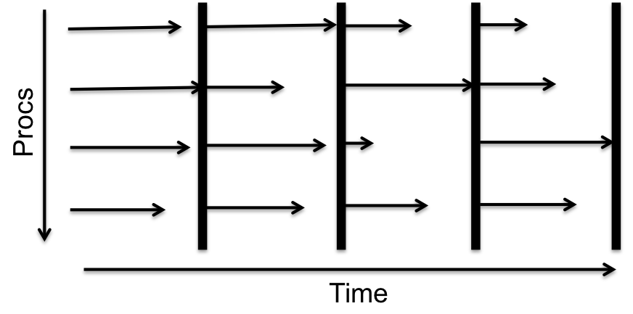
Load Imbalances Create a Performance Challenge
Massively-distributed bulk-synchronous applications
Global synchronization barriers at computation milestones
Performance determined by last processor to arrive at the barrier
Speed up slower processors
Slow down processors with slack (i.e., waiting on dependencies)
Notes:
Applications are iterative, bulk-synchronous

Slide 18
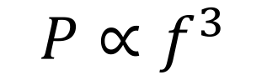
Power Saving Technique: Reduce CPU Frequency (DVFS)
Outcome: Takes longer to run, but uses less power
Why: Non-linear relationship between frequency and power →
Reduced clock frequency results in less power consumption
but, subcomponents still consume power at the same rate
✔ Will lead to power savings
✔ May lead to energy savings, may not
✖ Does not guarantee a specific power consumption
$$P∝f^{3}$$

Slide 19
Performance Under DVFS
Trade-offs between energy savings and runtime are dependent on application bottlenecks
DVFS typically only impacts the processor and private caches
Compute-bound
Memory/IO-bound
Notes:
We created 4 benchmark tests that vary in levels of compute and data intensity. Our most compute bound test performed several multiplication operations on a single variable.

Slide 20
Energy-Efficient Approaches
Offline Approaches
Online Approaches
Interval-Based
Iteration-Based
Slack-Based

Slide 21
Offline Approaches
Necessary step to understand value proposition
Approaches:
Simple: Single CPU frequency per application
Advanced: Multiple CPU frequencies per application
High overhead in collecting energy profiles, not ideal for production
Application
X
Application “Phases”
X
System Configuration
X
Available CPU Frequencies
Notes:
Trade-offs may change depending on bottleneck. For single node, bottleneck is memory, but with multiple nodes, bottleneck becomes communication.

Slide 22
Interval-Based Online Approaches
Energy-savings decisions are assessed at regular intervals of time
Future decisions are based on execution behaviors of previous interval
What metrics to use?
Instructions per cycle (IPC)
Misses per operation (MPO)
Beta metric: intensity of off-chip accesses (all misses)
Leading loads: memory-bound due to first miss
Low IPC = memory stalls slow exec rate
High MPO = more memory accesses

Slide 23
Ex: CPUFreq/CPUSpeed/CPUPower
Linux drivers to enable OS to statically/dynamically change CPU frequency to save power
Several “governors” = software heuristics for changing frequency
Not critical path aware, 15-25% power reduction can be achieved
Performance
Powersave
Userspace
Ondemand
Conservative
Static
Dynamic
Notes:
Assess current CPU load every X cycles and change frequency for next interval

Slide 24
Iteration-Based Online Approaches
Assume application iterations are identical
Decide frequency for next iteration
Ex: Jitter
Must modify source code to identify iteration boundary
Slow processors off critical path to arrive just-in-time, 8% energy savings, 2.6% increase in runtime
Works well on applications where critical path does not move between iterations
Increasing number of applications are non-temporal
Notes:
Iterative application: simulation

Slide 25
Slack-Based Online Approaches
Slack: Time spent blocked in an MPI communication call
i.e., processes not on the critical path
Goal: Find lowest frequency where no slack is incurred
i.e., processes arrive at the same time
Ex: Adagio
No markup to application
Approximates lowest frequency as it may be unavailable on given CPU
Achieves 20% energy savings with <1% slowdown by being critical path aware
Notes:
Assumes that task behavior with be identical every time it is executed

Slide 26
Comparing Approaches
Energy-efficient approaches explore trade-offs between energy usage and performance
Assume we want to apply an energy-efficient approach to an application:
Approach A:
Saved 5% in energy usage
Increased runtime by 2%
Approach B:
Saved 8% in energy usage
Increased runtime by 4%
Which approach is better?

Slide 27
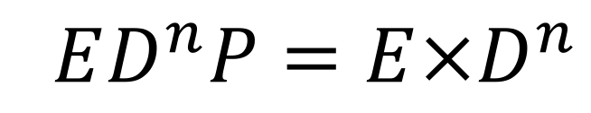
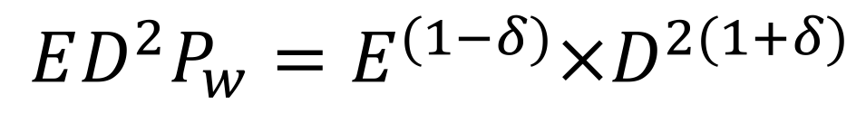
Evaluation Metrics
Create a single scalar metric quantifying slowdown and energy usage
Energy-delay product (EDP)
n indicates preference towards acceptable slowdown
Weighted ED²P
User-specifies preference towards energy savings or performance slowdown
$$ED^{n}P=E×D^{n}$$
$$ED^{2}P_{w}=E^{(1−δ)}×D^{2(1+δ)}$$
Notes:
The higher the n value, the heavier the performance constraint. ED3P will have a smaller performance loss than ED2P.

Slide 28
Additional Metric: Energy Reliability
Exascale systems will experience more frequent failures (at least once a day)
Energy usage increases to provide reliability mechanisms
e.g., cooling, checkpoints/restarts, backup components
Slowdowns due to DVFS increase likelihood of encountering a failure, impacting overall energy savings

Slide 29
Outline
Motivation & Background
Energy-Efficient Techniques for HPC
Power-Constrained Techniques for HPC
Scientific Visualization
Power-Aware Visualization & Future Work
Notes:
First, I’ll cover some background information.

Slide 30
What is Power-Constrained?
Power is the constrained resource at exascale
Goal: Maximize power efficiency by increasing system job throughput
How: Applications will need to be flexible with resource allocations (e.g., power, nodes, execution time)
c/o T Patki
c/o T Patki
Notes:
”Do the most science”

Slide 31
HPC System Design Approaches
Worst-Case Provisioning (current approach)
Assume every node consumes peak power simultaneously
Hardware Overprovisioning
More nodes exist than can be fully powered simultaneously under the bound
Benefits:
Dynamic system configuration based on application execution
Increase system throughput by reallocating power where it is most needed
Notes:
There are two approaches for designing an exascale system.
Worst-case provisioning: Traditional approach targeting highly compute-intensive applications (e.g., Linpack)
Hardware overprovisioning: Approach targeted at future power-constrained systems, technique already implemented by processors (core frequency is dependent on number of active cores and all cores cannot be running at the highest frequency)

Slide 32
Power Saving Technique: Reduce Concurrency
Change number of threads executing in parallel region
Less overhead than DVFS
Beneficial on architectures with shared clock frequencies between CPU and shared cache
✔ Will lead to power savings
✔ May lead to energy savings, may not
✖ Does not guarantee a specific power consumption
Notes:
From “Power Measurement and Concurrency Throttling for Energy Reduction in OpenMP Programs”: By limiting the number of active threads, the runtime can reduce the instantaneous power demand, but the effect on overall energy usage depends on how overall execution time is changed by running on fewer hardware threads. When shared hardware resources (last-level cache, memory or network bandwidth) are oversubscribed, reducing the number of threads will not significantly affect total execution time. In this case fewer active threads can result in energy savings. However, if there is little interaction between threads and hardware resources are sufficient to support their execution, decreasing the number of threads will result in longer execution time and an increase in the overall energy utilization for the application.

Slide 33
Power Saving Technique: Power Capping
Enforce an upper bound on power consumption, hardware toggles CPU frequency/voltage
Supported by Intel, AMD, IBM processors
✔ Will lead to power savings
✔ May lead to energy savings, may not
✔ Guarantees specific power consumption
Performance under DVFS has been well-studied, but performance under a power cap will pose new challenges.
Notes:
Guarantees specific power consumption irrespective of frequency variations due to manufacturing variations

Slide 34
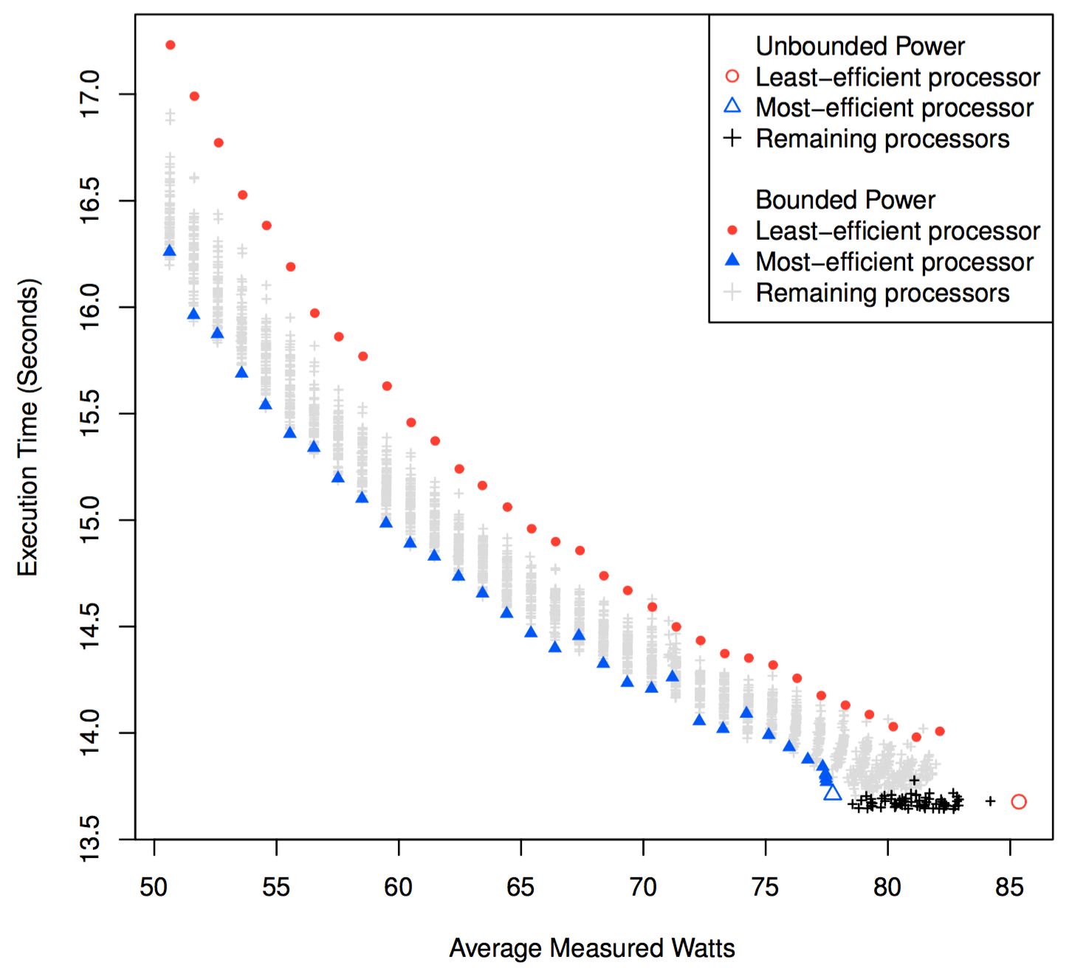
CPU Performance Under a Power Bound
Processor manufacturing is imperfect
Unbounded power: Constant execution time, variation in power draw
Bounded power: Constant power draw, variation in execution time
c/o B Rountree
Notes:
33 power bounds between 51W and 83W
Each point represents single run and corresponding performance on each of the 64 processors

Slide 35
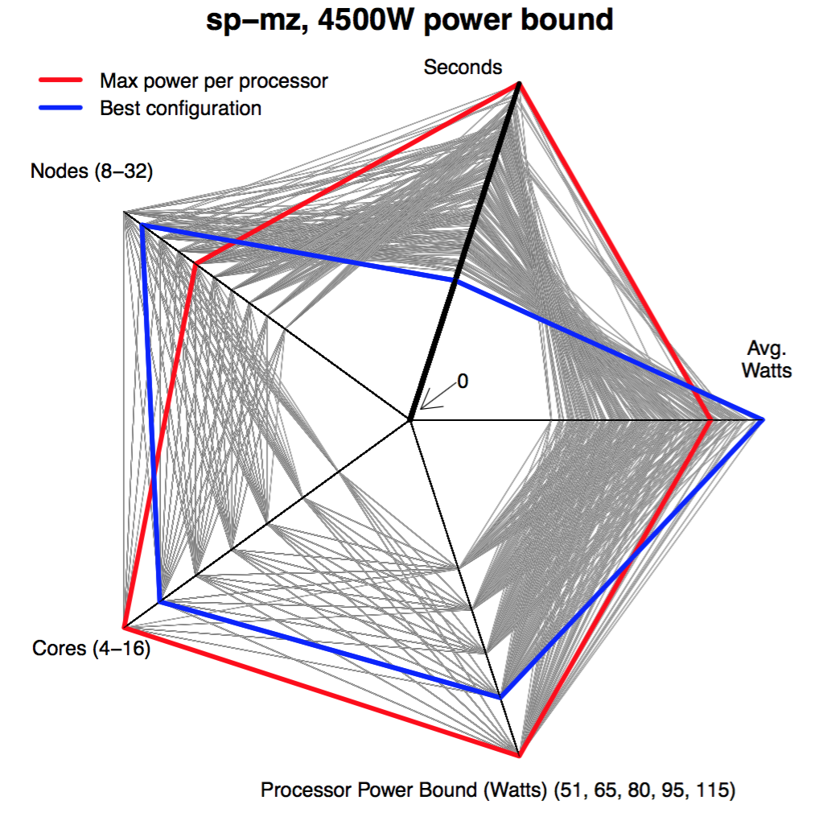
Job Performance Under a Power Bound
Explore configuration space < job-level power bound
3 inputs: power bound, cores, nodes
2 outputs: seconds, avg. watts
Initial configuration: 115W, 16 cores/node, worst time
Best configuration: 95W, 14 cores/node, 2X faster time
c/o T Patki
Notes:
sp = computational fluid dynamics
mz = multi-zone

Slide 36
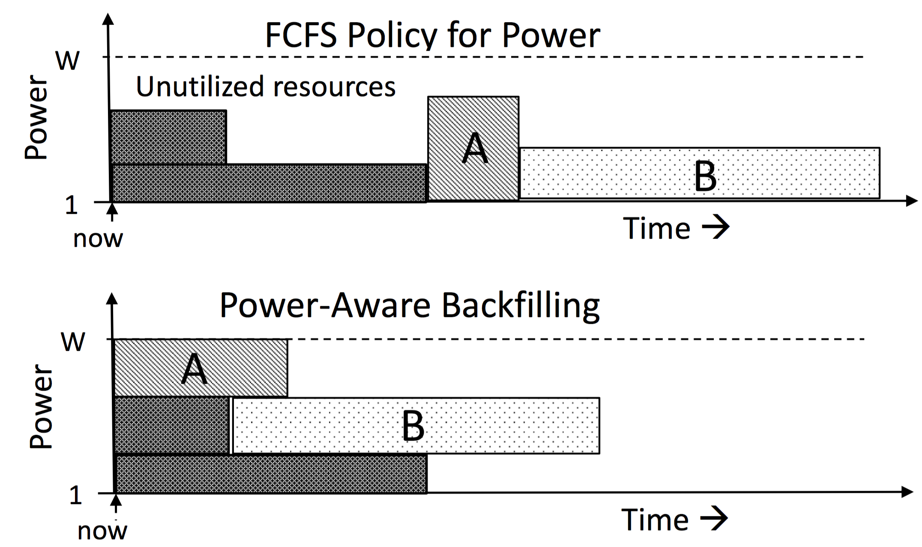
System Performance Under a Power Bound
First Come First Serve
Power-Aware Backfilling
✖
✔
Goal: Create fairness across jobs on machine shared by many
Job A: power request exceeds current available resources → long queue time
Job B: request fits in resources, but must wait until Job A finishes
Goal: Use as much power when scheduling jobs
Job A: Adjust request → extend runtime, but reduce queue time
Jobs submit a “laundry list” of tunable knobs (e.g., concurrency, algorithm, slowdown)
c/o T Patki
Notes:
FCFS: simple to implement and ensures fairness, but can block several small jobs in the job queue when a job requesting more resources (large node count) is waiting for its request to be granted. Also leads longer wait times as nodes are not utilized efficiently (several nodes remain idle as the requirements of the next job cannot be met immediately).
Backfilling: addresses the problems of FCFS by executing smaller jobs out of order on the idle nodes while the next job (typically large) is waiting for resources.

Slide 37
Dynamically Reallocate System Power
Further benefits job performance as they’re running
Ex: powsched
Central manager dynamically shifts power between nodes based on current CPU power usage
Agnostic to jobs running on each node
Must guarantee system power bound is not exceeded, while fully utilizing all power

Slide 38
Outline
Motivation & Background
Energy-Efficient Techniques for HPC
Power-Constrained Techniques for HPC
Scientific Visualization
Power-Aware Visualization & Future Work
Notes:
First, I’ll cover some background information.

Slide 39
Scientific Visualization
Central actor in scientific discovery process:
Communicate
Explore
Validate
Data
Apply
Filter
Render
Image
Display
Notes:
Previous research and development of these energy-efficient and power-constrained approaches used standardized synthetic benchmarks. Exascale will create an overhaul in our system, and we will need to understand how these approaches impact scientific applications. Scientific visualization is an application that will need innovation to fit within the power constraint. Scientific visualization plays a central role in scientific discovery process. Visualization pipeline transforms data into comprehensible images.

Slide 40
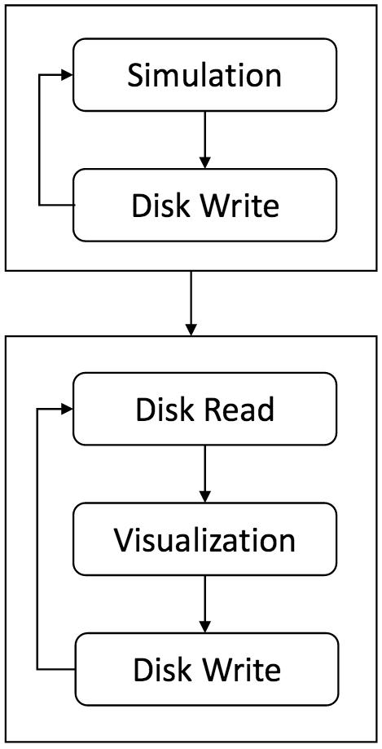
Post-Processing (Traditional Model)
Simulation writes data to disk at regular time steps
Visualization reads in data, performs analysis, and writes results to disk
Time step 20, 40, 60, …
Apply filter, render image
c/o V Adhinarayanan

Slide 41
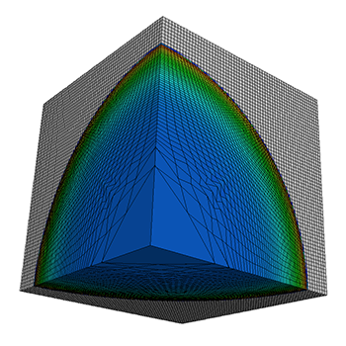

Challenges of Post-Processing Model
Simulations are greatly increasing in the amount of data per time step they can generate
I/O bandwidth limitations widen gap between time steps
Step 0
Step 500
Step 1000
c/o M Larsen
Notes:
The ability to generate data is going up much faster than the ability to store/retrieve data.

Slide 42
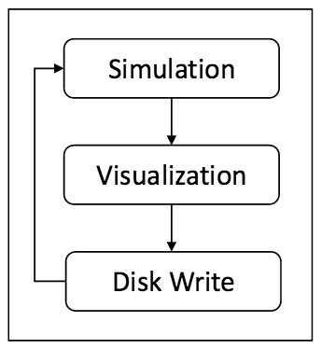
Transition to In Situ to Bypass I/O Gap
Data analysis and visualization occur while simulation is running
Share job resource allocations
No storage needed between simulation and analysis
c/o V Adhinarayanan

Slide 43
Outline
Motivation & Background
Energy-Efficient Techniques for HPC
Power-Constrained Techniques for HPC
Scientific Visualization
Power-Aware Visualization & Future Work

Slide 44
Power-Aware Visualization
Very limited research in this space
Research efforts so far:
What is the difference in power consumption between traditional post-process approach and in situ?
How do software knobs (e.g., concurrency, algorithm, parallel programming model) affect energy and power savings of visualization algorithms?
How does in situ data movement (e.g., no movement, intra-node, inter-node) impact power?

Slide 45
Dissertation Proposal
Interests lie in how power constraints will impact visualization
Goal: Understand what parameters impact energy and power usage of visualization routines
How: Use energy-efficient and power-constrained techniques to build a power-aware visualization framework for exascale computing

Slide 46
Future Work
What tunable knobs exist, such that the application is moldable to the available resources?
How do the knobs apply to different visualization routines?
How much speedup can be gained from shifting power between nodes during phases in the pipeline?
Notes:
Particle advection: data-dependent memory accesses, which may lead to more favorable propositions
Volume rendering: requires significant computation and irregular memory acceses (especially for unstructured grids)

Slide 47
Summary & Questions
Power will be a key challenge at exascale
All system components will need power-efficient innovations
Power-aware scientific visualization is important to continued scientific discovery
“Energy-Efficient and Power-Constrained Techniques for Exascale Computing”
Stephanie Labasan
slabasan@cs.uoregon.edu

Slide 48
Backup

Slide 49
FLOPS-Focused
Measuring performance in FLOPS has created two problems:
Supercomputers consume high electrical power
Supercomputers generate high amounts of heat, necessitating large cooling infrastructures for system reliability

Slide 50
A New Performance Metric
Green500 list complements Top500
Created in Nov 2007
Ranks by performance-per-watt
Promotes improved energy efficiency, system reliability
Rank | System | GFLOPS/Watt | Power (kW) | Top500 Rank
1 | Shoubu, Japan | 6.7 | 150 | 94
2 | Satsuki, Japan | 6.2 | 46.9 | 486
3 | Sunway TaihuLight, China | 6.1 | 15371 | 1
4 | GSI Helmholtz, Germany | 5.3 | 57.2 | 440
c/o Green500, Top500, Jun2016

Slide 51
Moore’s Law & Dennard Scaling
Moore’s Law
Dennard Scaling
# of transistors per chip doubles every 18-24 months at constant cost
The smaller the transistor size, the faster it can switch states (i.e., frequency)
Voltage and current should be proportional to the linear dimensions of a transistor
Thus, as transistors shrank, so did necessary voltage and current; power is proportional to the area of the transistor.

Slide 52
Breakdown of Dennard Scaling
Dennard ignored leakage power, which sets a base power consumption per transistor
As transistors shrank in size, power density increases leakage power does not scale with size
Hence, frequency has stagnated to around 4 GHz since 2006

Slide 53
Power Monitoring & Control
External
Internal
Coarse-Grained
Fine-Grained
Vendor-Specific
Temporal Granularity
Spatial Granularity
Lots of different tools for monitoring and controlling power. Not the focus of this presentation, but is relevant to enabling this research.

Slide 54
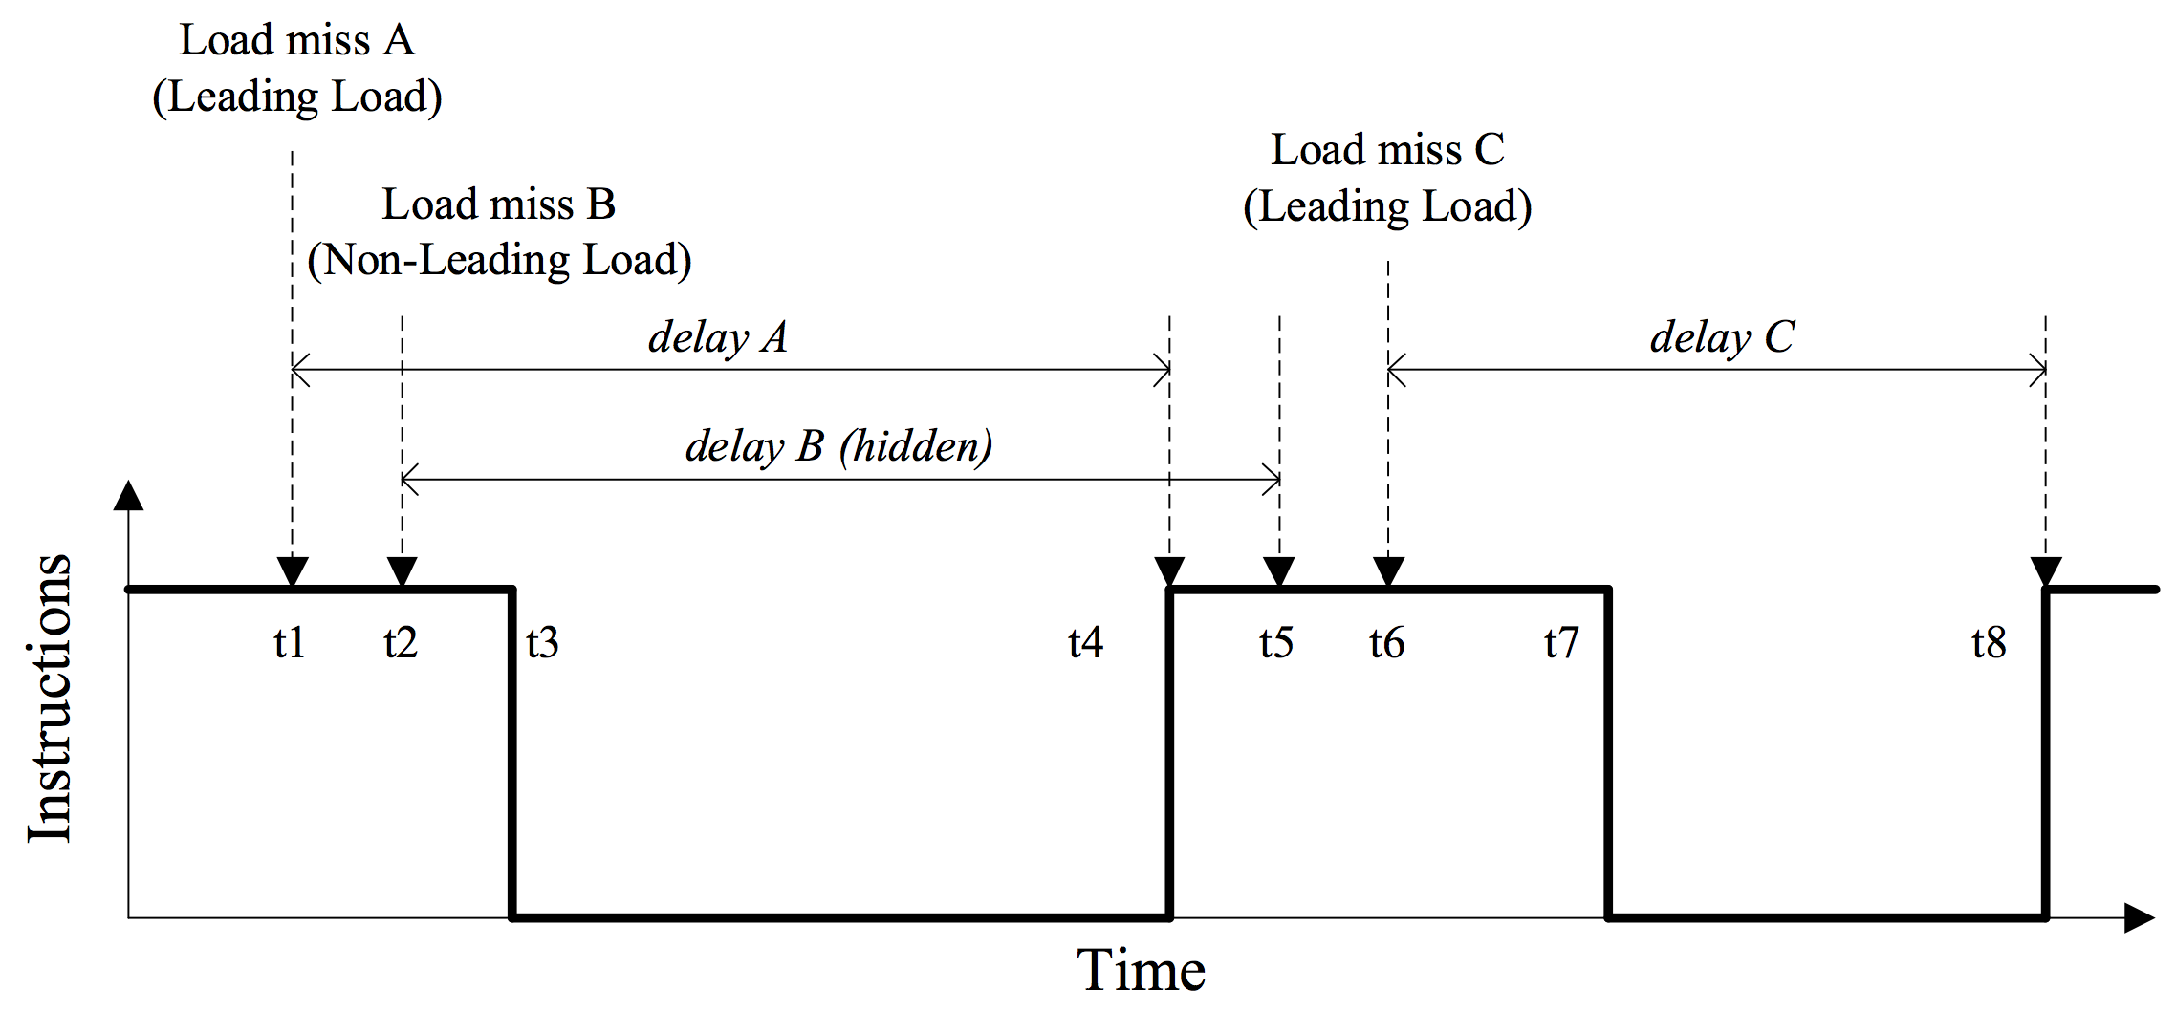
Leading Loads
Only first memory access can stall the pipeline. Do not count subsequent misses occuring before the leading load has returned.
c/o “Implementing a Leading Loads Performance Predictor on Commodity Processors”

Slide 55
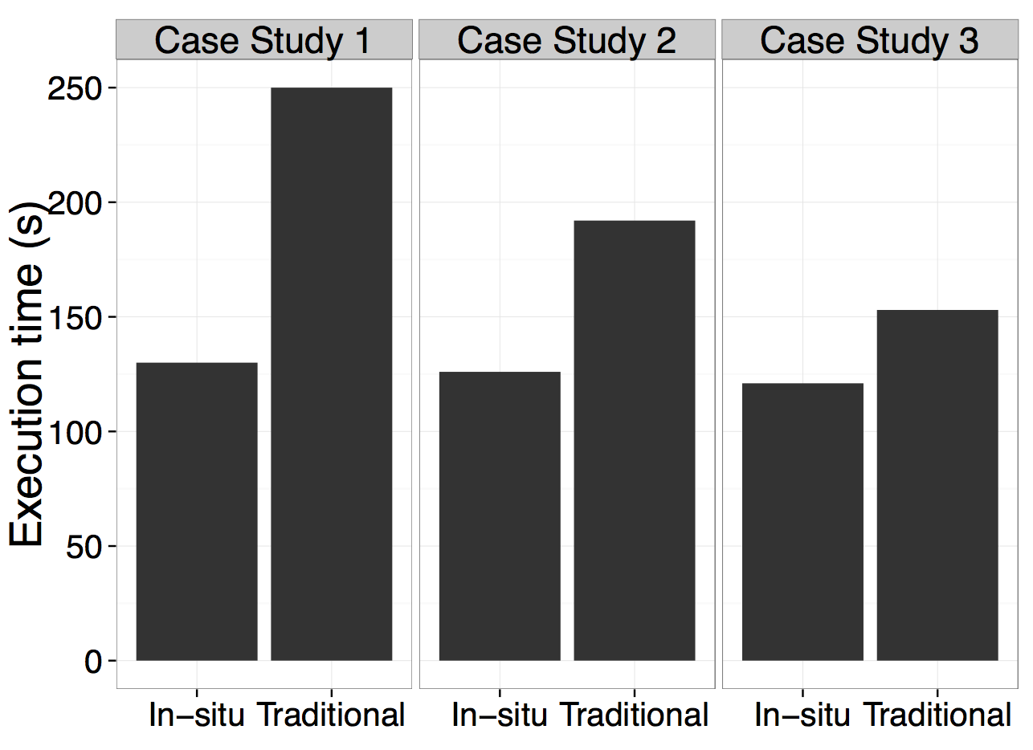
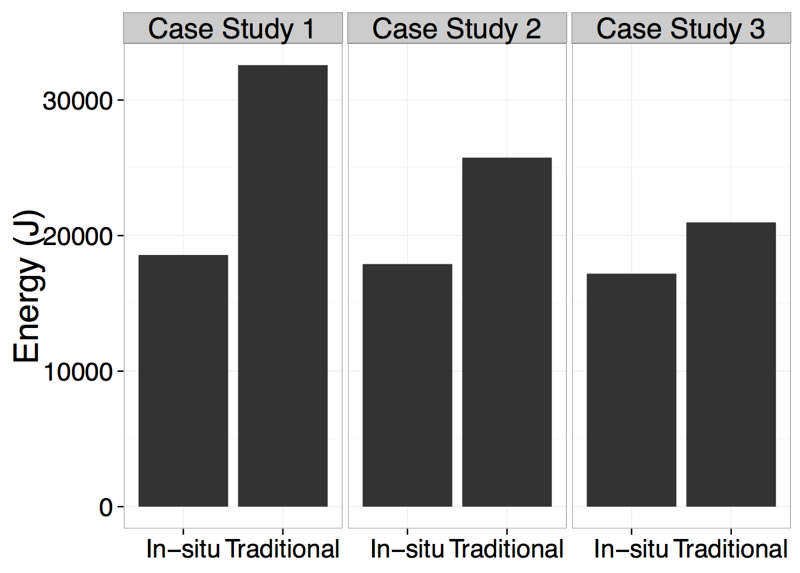
Post-Process vs. In Situ Power Usage
In situ completes faster, uses less energy, though the average power usage is higher than post-processing. Reducing I/O times with in situ is more energy efficient.

Slide 56
In Situ Data Movement Strategies
Use the same compute resources as the simulation, but have different data movement patterns
No data movement: Analysis uses all the compute nodes allocated to simulation, which may be optimal for simulation, not analysis
Off-node: Analysis uses a subset of nodes, frequency of data transfer limited by I/O bandwidth
On-node: Analysis uses a few number of cores per node, data transferred with shared memory
Up to a certain point does using all cores per node benefit execution time and energy usage (with high power consumption). Using fewer cores per node is a more scalable solution for performance and energy and power usage.

Slide 57
Classifying Application Behaviors (cont’d)
Beta metric:
Intensity of off-chip (memory) accesses
1: Performance will scale with a reduction in frequency
0: Performance is independent of the frequency
Leading loads:
Track number of cycles spent performing non-speculative read resulting in LLC miss

Slide 58
Current System Power Usage
5 PF, peak
←
2.3 MW, Linpack
3 PF, “usable”
24,576 nodes
c/o T Patki
Notes:
As of June 2016, Vulcan is the 14th fastest supercomputer in the world with 5 PF. It contains 24,576 nodes. Assuming every node can consume 100W in the worst-case, this machine is procured for 2.4 MW. Looking forward, there are two scenarios.

